Slide 1
KVS weekly report

Slide 2
Outline
MongoDB and NoSQL database
MongoDB storage engines
RocksDB and its design

Slide 3
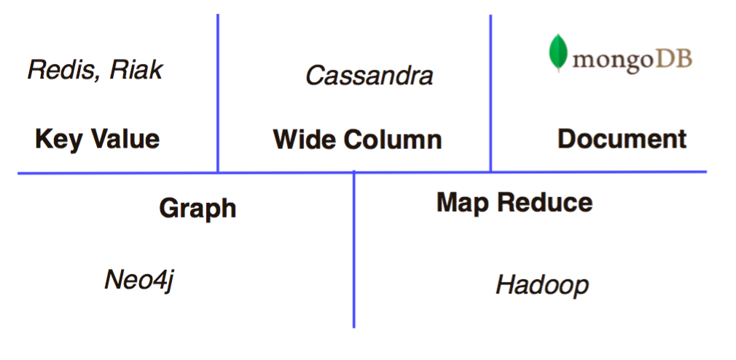
NoSQL Databases
Categories of NoSQL databases
[1] Referenced from Introduction to new high performance storage engines in MongoDB 3.0 on www.slideshare.net

Slide 4
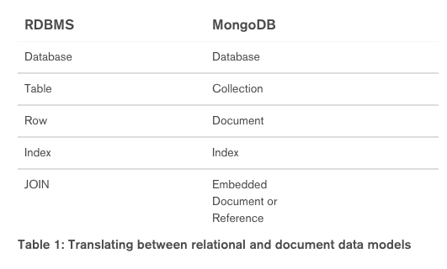
MongoDB
Document-based database: Each document has JSON-style format, which contains many field-value pairs
var mydoc = {
_id:
ObjectId("5099803df3f4948bd2f98391"),
name: { first: "Alan", last: "Turing" },
birth: new Date('Jun 23, 1912'),
death: new Date('Jun 07, 1954'),
contribs: [ "Turing machine” ],
views : NumberLong(1250000)
}
[2] Referenced from Thinking in Documents: Part 1 blog post.

Slide 5
MongoDB Storage Engine
Storage engine: Manage how data is stored on disk.
Default storage engine for MongoDB is mmapv1
They also support WiredTiger storage engine officially, which is better for caching and compressing data.
Why we need many different storage engines
[3] Referenced from MongoDB World 2014 Recap blog post.

Slide 6
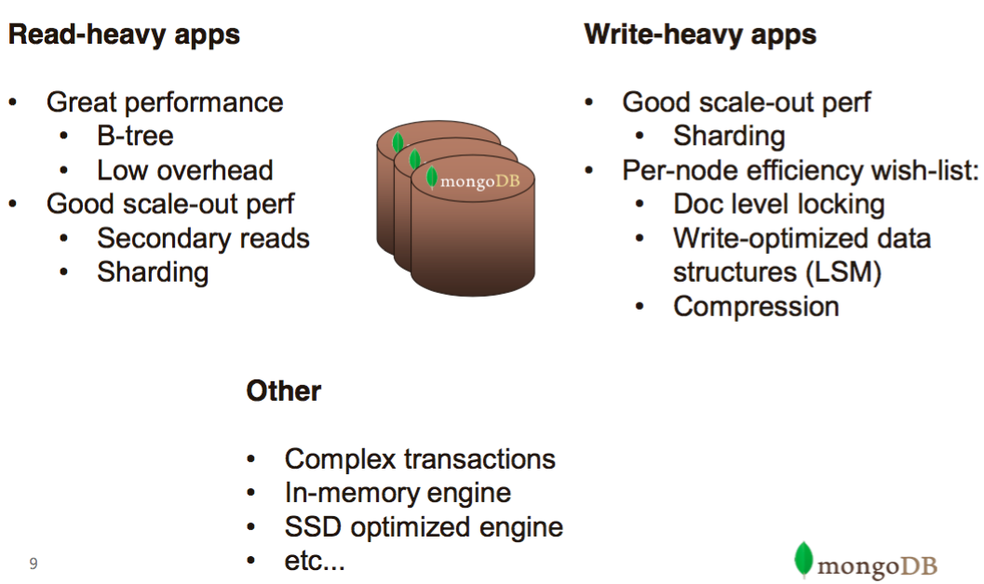
MongoDB Storage Engine
[4] Same as [1]

Slide 7
RocksDB
RocksDB is an embeddable persistent key-value store for fast storage.
Developed by Facebook, and built on LevelDB.
Features
RocksDB is a C++ library, which supports many KV operations.
Suitable for low access latency applications.
Only LSM support for MongoDB storage engine*.
* Announced by Facebook on http://blog.parse.com/announcements/mongodb-rocksdb-parse/

Slide 8
RocksDB
Operations
Open Database: rocksdb::DB::Open(options, "/tmp/testdb", &db);
Read: db->Get(rocksdb::ReadOptions(), key1, &value);
Write: db->Put(rocksdb::WriteOptions(), key2, value);
We’ll use these operations to build MongoDB storage engine.

